Slide 1
Graduation project
GPS module

Slide 2
GPS in WAP
the phasor, and, in particular, its phase-angle, is calculated using Coordinated Universal Time (UTC) as a time reference.
Such choice allows having a unique reference for all the sinusoidal signals to be measured in a wide or global area, because the time dissemination relies on satellite systems.

Slide 3
GPS in WAP
Two synchrophasors, calculated at different points in a network, can be easily compared because they are related to common instants.
In other words, the synchrophasor measured at a generic UTC reference time instant “Tr “represents the rms amplitude and the phase-angle of the sinusoidal signal at T .

Slide 4
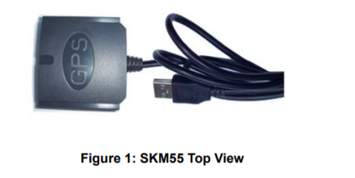
GPS module”SKM55RM”

Slide 5
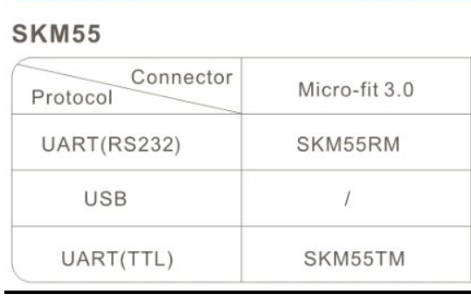
GPS module”SKM55RM”

Slide 6
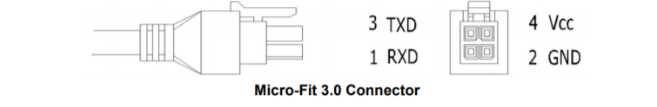
GPS module”SKM55RM”

Slide 7
Hardware Interfaces Configuration
UART Ports:
The SKM55 series supports one full duplex serial channels UART.
The serial connections are at 2.85V LVTTL logic levels, if need different voltage levels, use appropriate level shifters. the data format is however fixed: X, N, 8, 1, i.e. X baud rate, no parity, eight data bits and one stop bit, no other data formats are supported, LSB is sent first. The modules default baud
rate is set up 9600bps.

Slide 8
Hardware Interfaces Configuration
RS232 Ports:
The SKM55 series uses single-chip RS232 to UART bridge, It is 3V powered EIA/TIA-232 and V.28/V.24 communication interfaces with low power requirements.

Slide 9
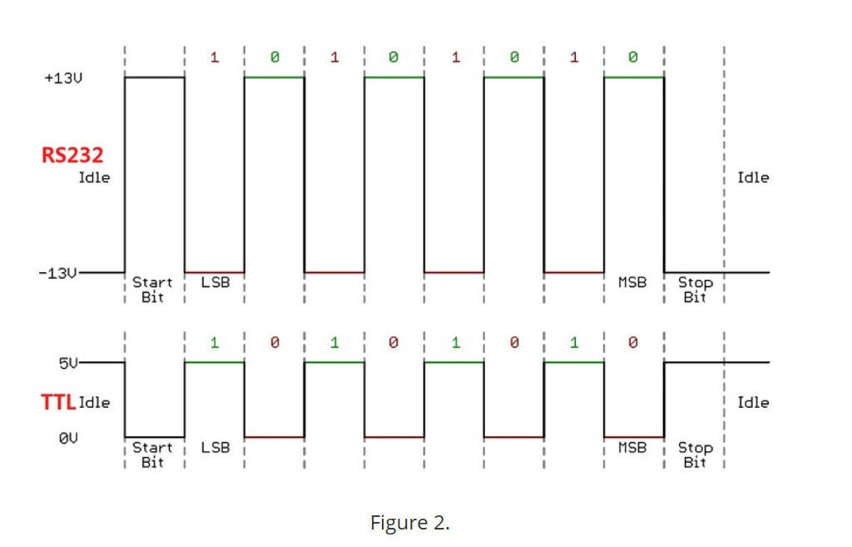
Hardware Interfaces Configuration

Slide 10
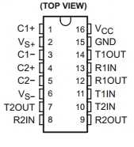
RS232 protocol to TTL protocol
*Using max232 IC as logic shifter.

Slide 11
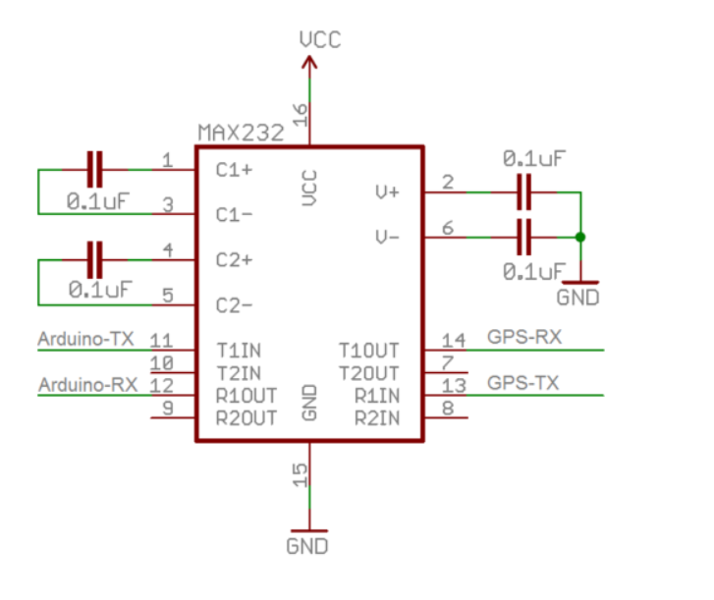
MAX232 connection
Using Atmega 128 instead of Arduino in our case.

Slide 12
Software Protocol
NMEA 0183 Protocol :
The NMEA protocol is an ASCII-based protocol,
records start with a “$ “and with carriage return/line feed.
GPS specific messages all start with $GPxxx where xxx
is a three-letter identifier of the message data that
follows.
NMEA messages have a checksum, which allows detection of corrupted data transfers.

Slide 13
Software Protocol
NMEA Record Description
GGA Global positioning system fixed data.
GLL Geographic position-latitude/longitude.
GSA GNSS DOP and active satellites.
GSV GNSS satellites in view .
RMC Recommended minimum specific
GNSS data .
VTG Course over ground and ground speed.
ZDA Date and Time

Slide 14
Software Protocol
GGA-Global Positioning System Fixed Data :
“$GPGGA,021514.000,2232.1799,N,11401.1823,E,1,6,1.25,84.0,M,-2.2,M,,*74 “.
This sentence contains the position, time and quality of the navigation fix.
“Nema protocol,UTC,Latitude,N,Longitude,E,PF,......”

Slide 15
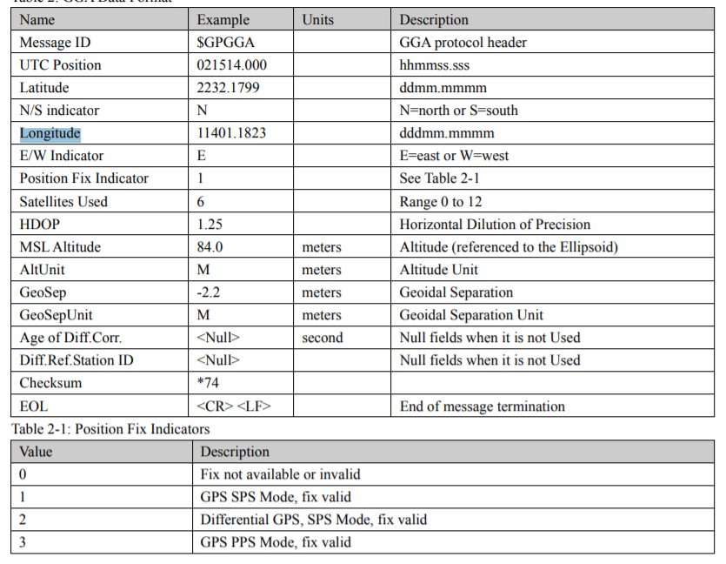

Slide 16
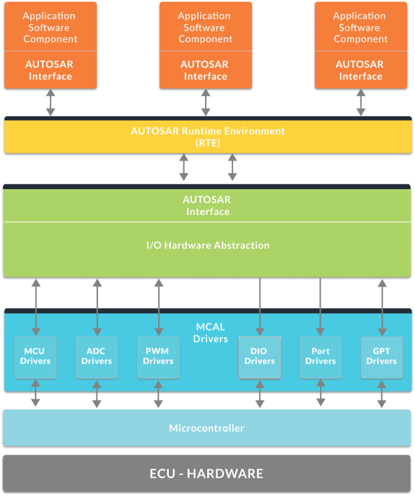
Software layers

Slide 17
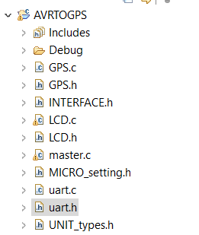
Software layers

Slide 18
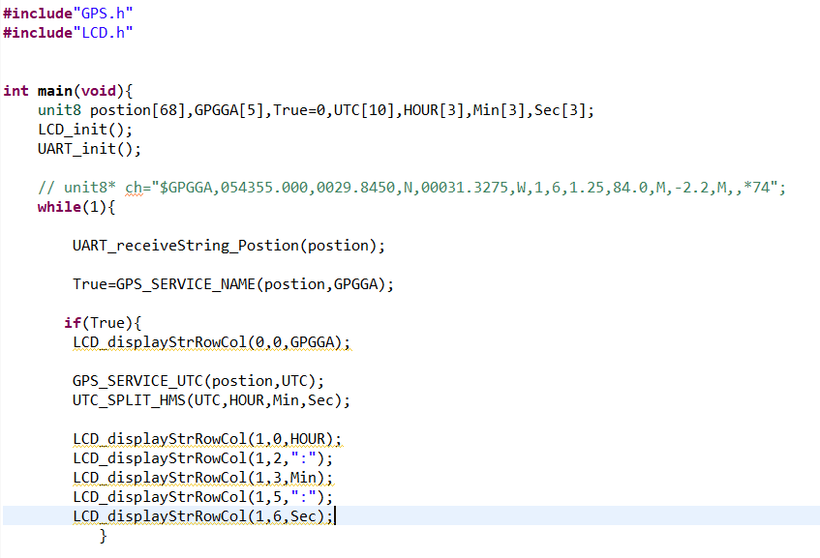
Software code using embedded C

Slide 19
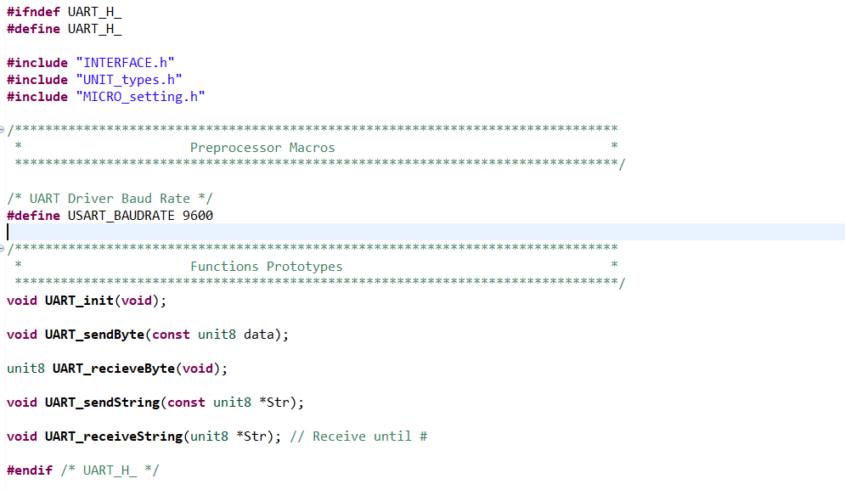
Software code using embedded C

Slide 20
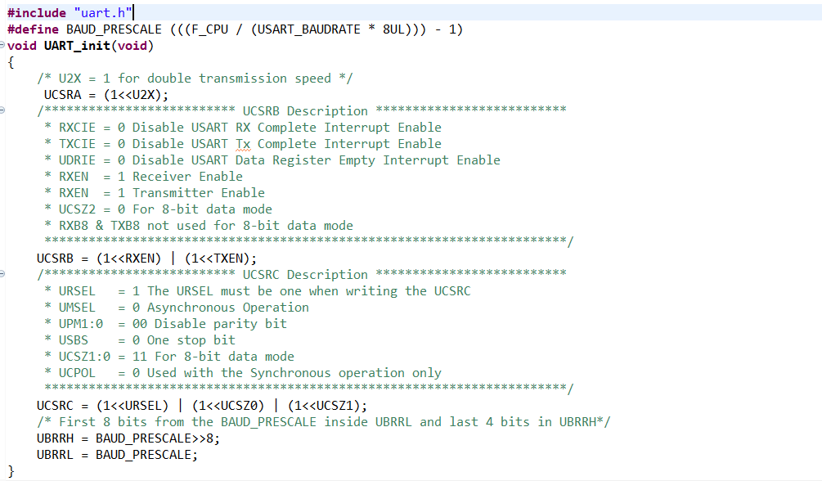
Software code using embedded C

Slide 21
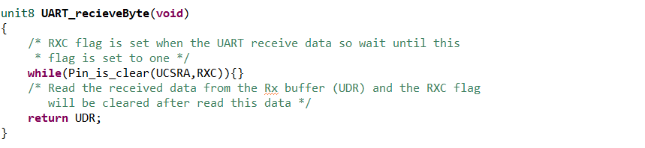
Software code using embedded C

Slide 22
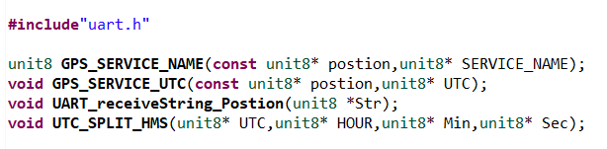
Software code using embedded C

Slide 23
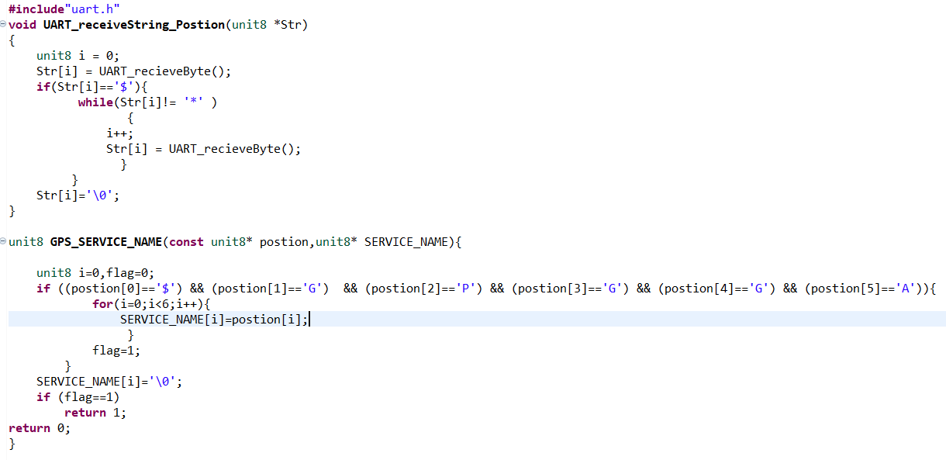
Software code using embedded C

Slide 24
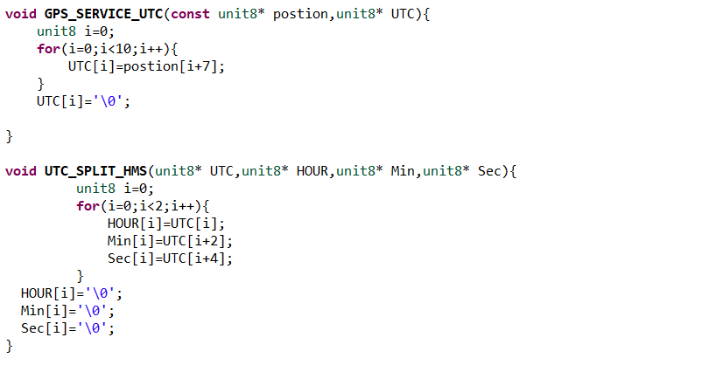
Software code using embedded C

Slide 25
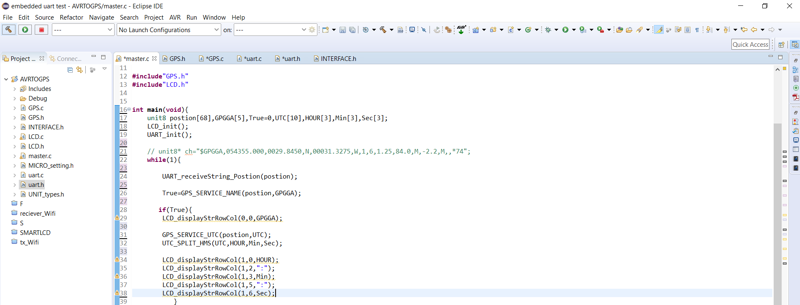

Slide 26
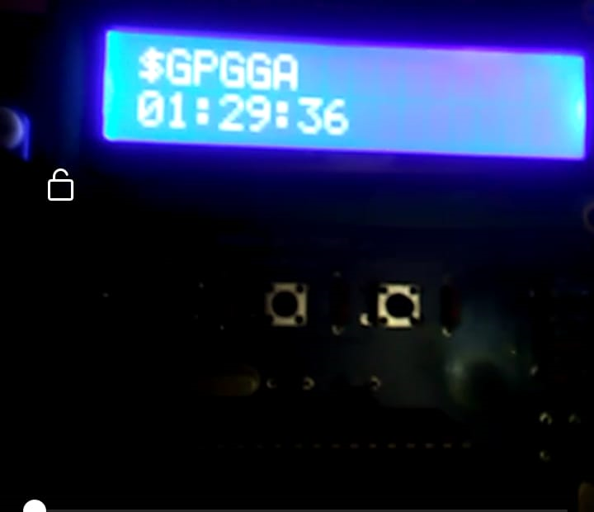

Slide 27
Graduation project
HMI modules

Slide 28
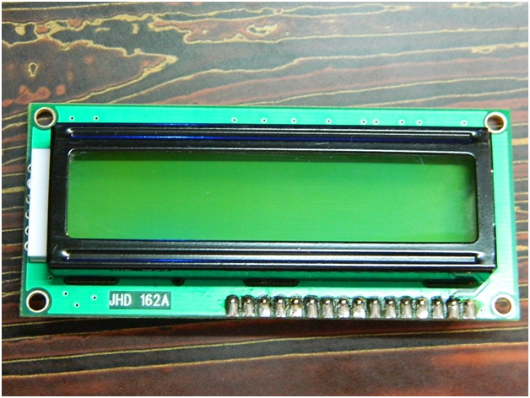
LCD LM016

Slide 29
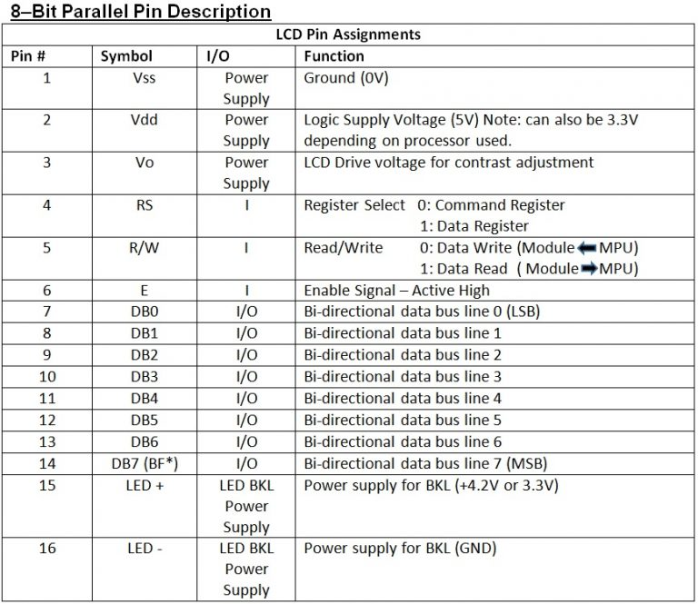
LCD LM016

Slide 30
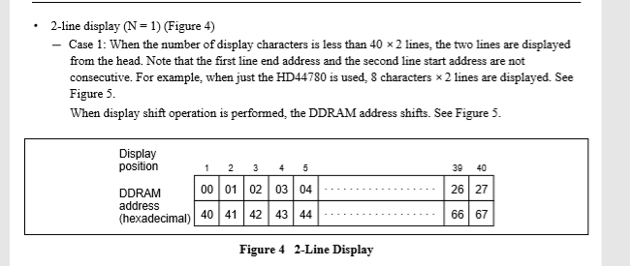
LCD LM016

Slide 31
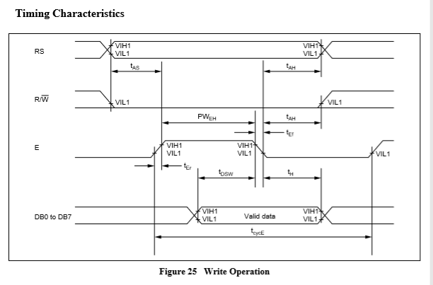
LCD LM016

Slide 32
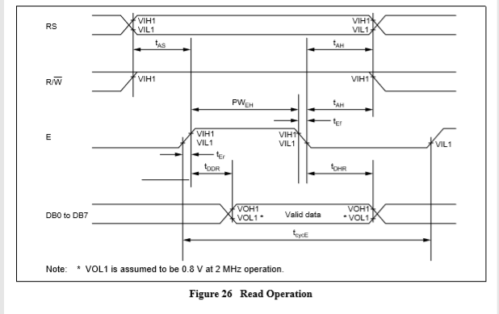
LCD LM016

Slide 33
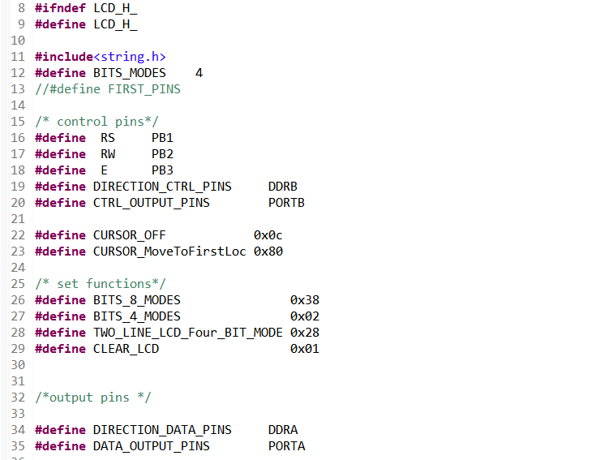
LCD LM016

Slide 34
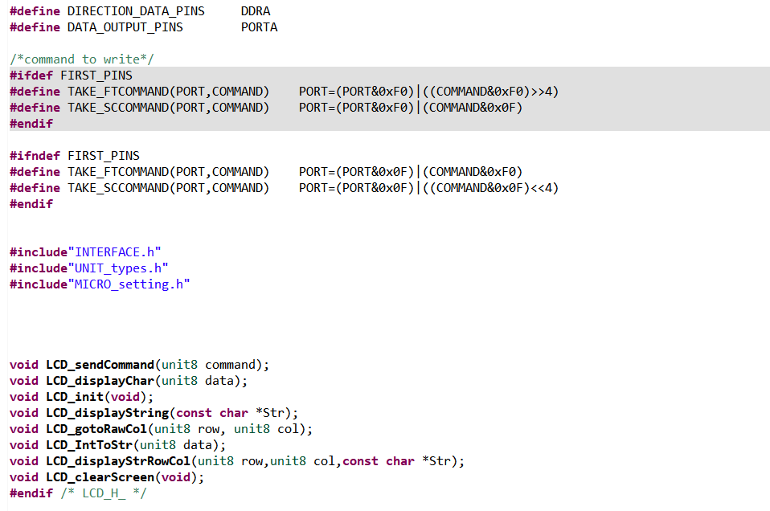
LCD LM016

Slide 35
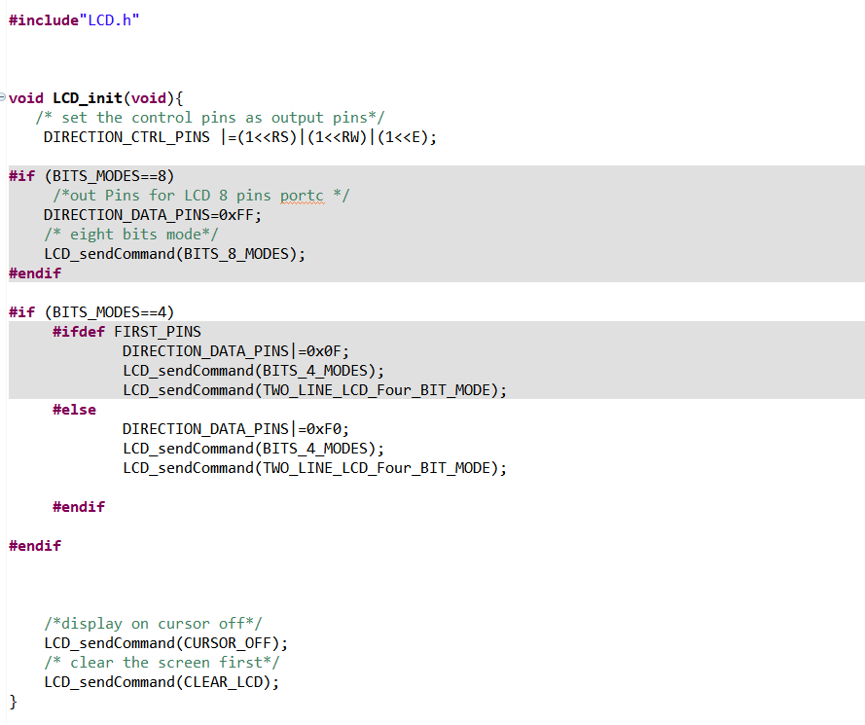
LCD LM016

Slide 36
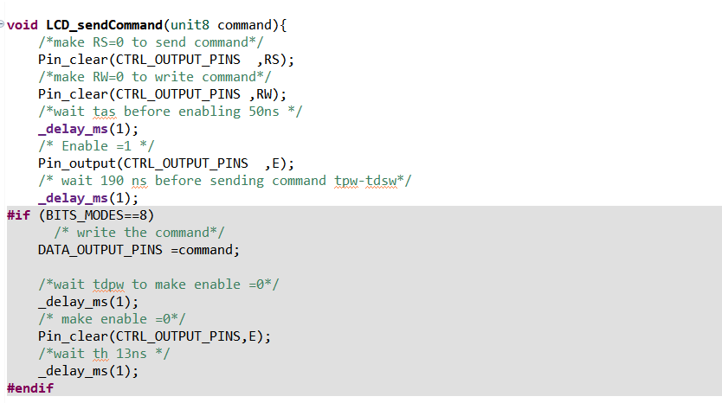
LCD LM016

Slide 37
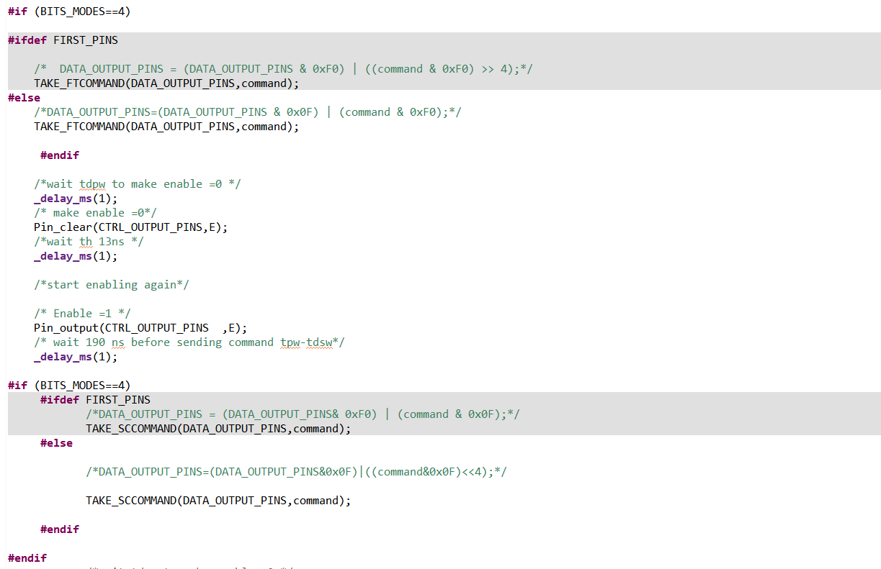
LCD LM016

Slide 38
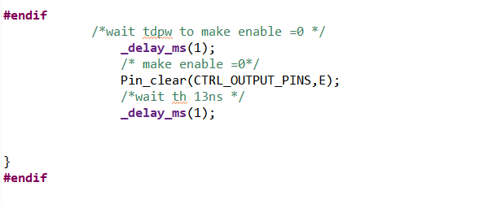
LCD LM016

Slide 39
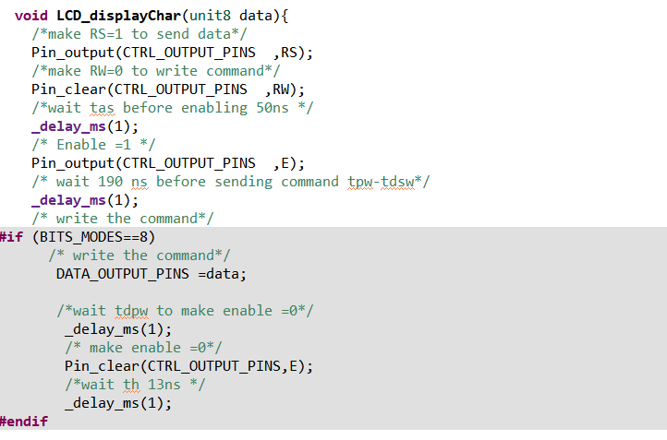
LCD LM016

Slide 40
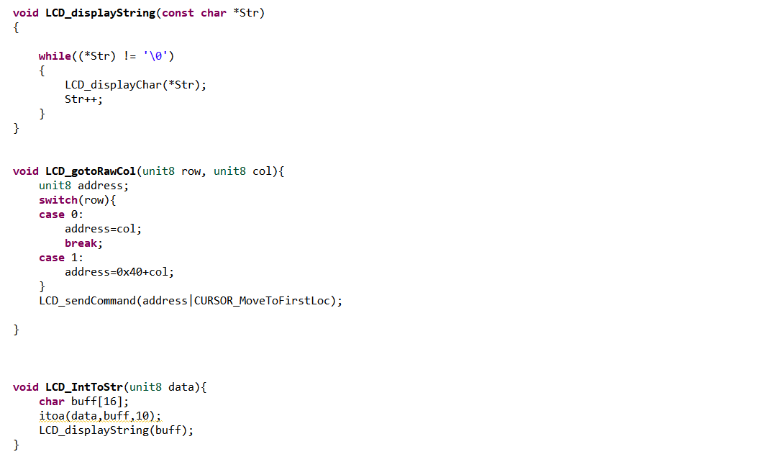
LCD LM016

Slide 41
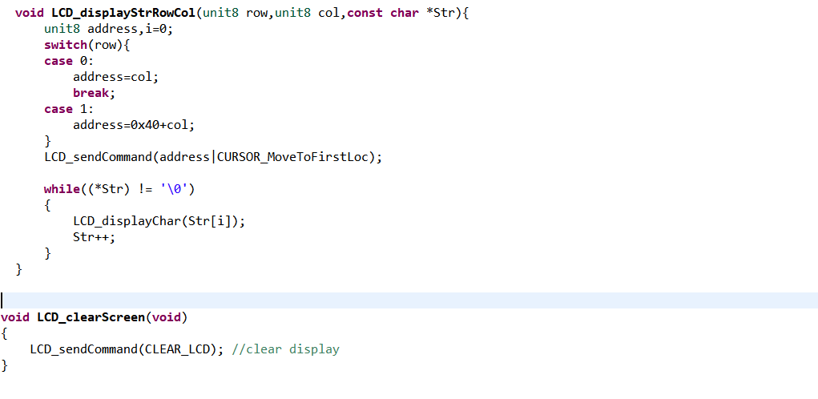
LCD LM016

Slide 42
SMART TOUCH LCD

Slide 43
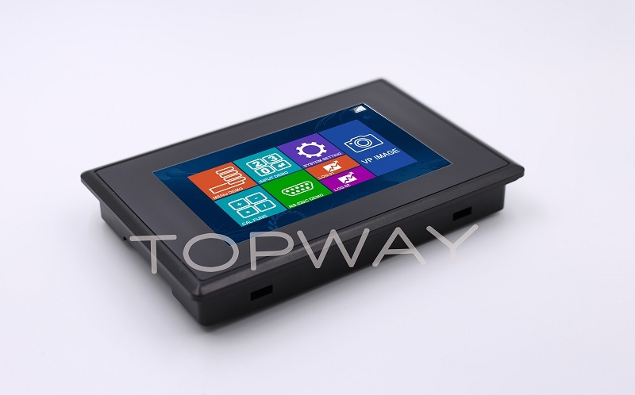
SMART TOUCH LCD

Slide 44
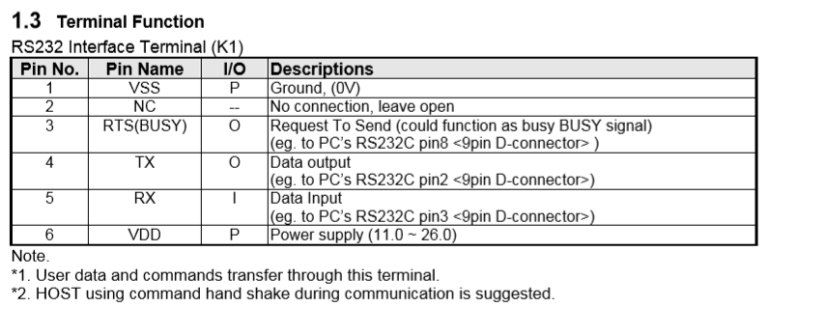
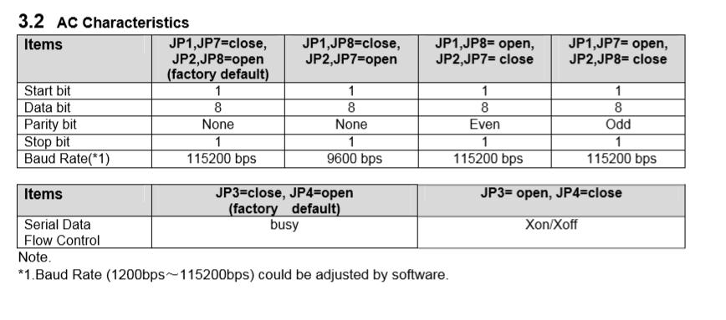
SMART TOUCH LCD

Slide 45
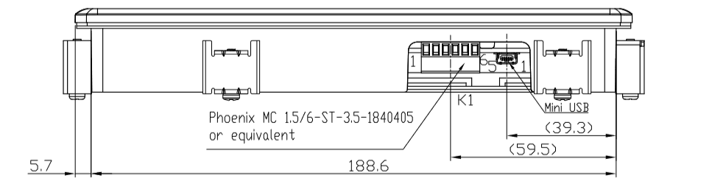
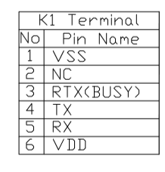
SMART TOUCH LCD

Slide 46
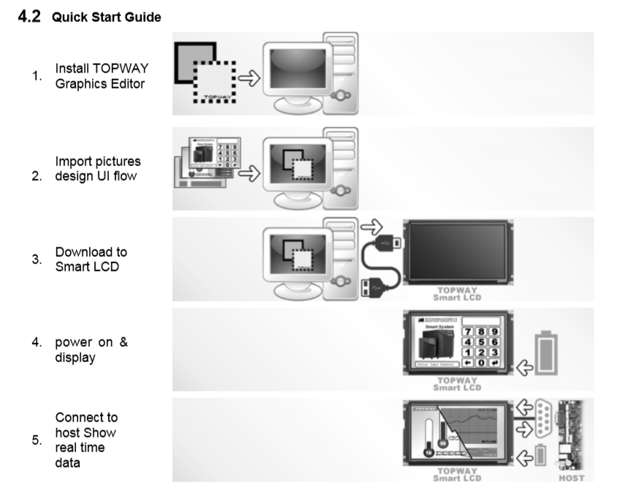
SMART TOUCH LCD

Slide 47
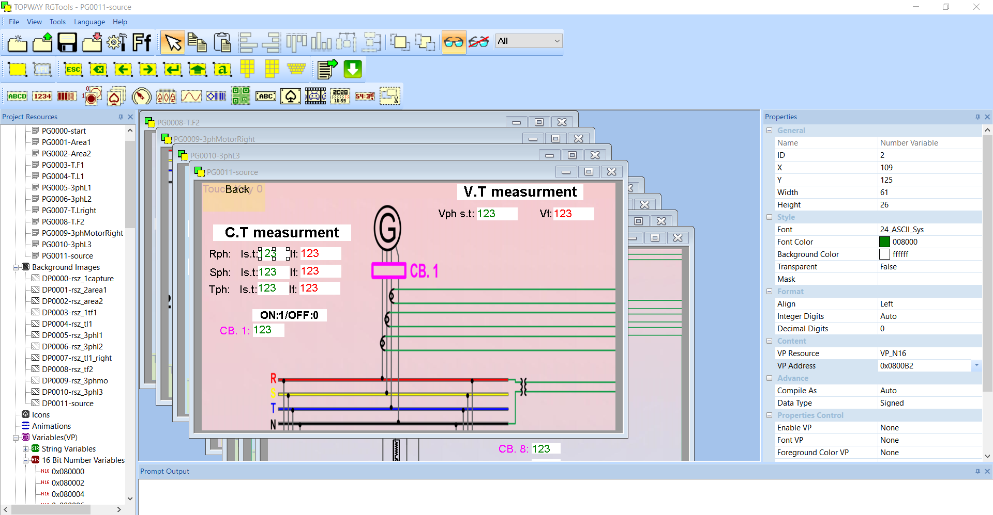
SMART TOUCH LCD

Slide 48
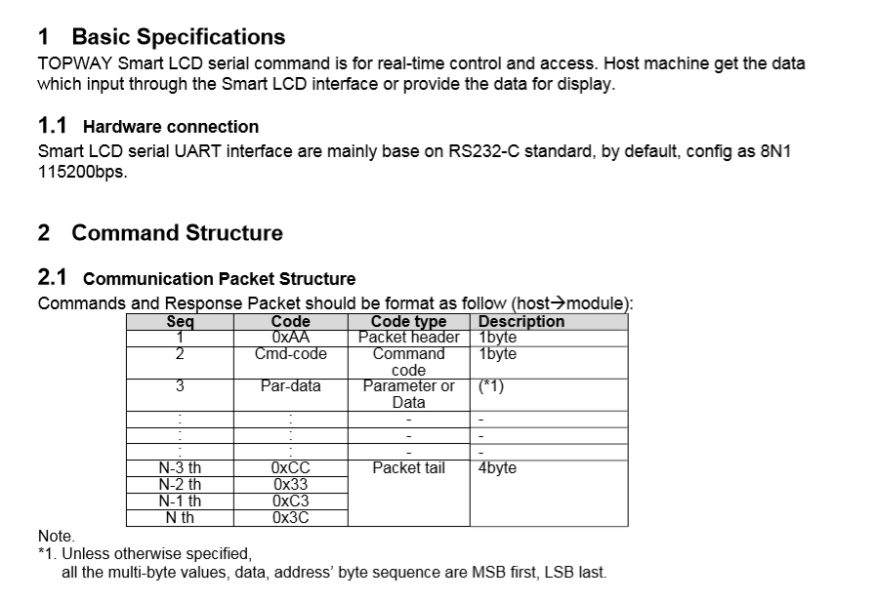
SMART TOUCH LCD

Slide 49
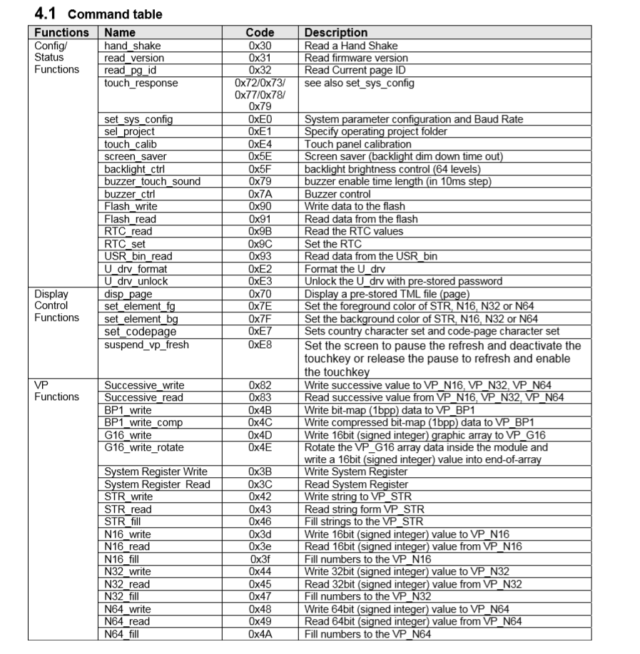
SMART TOUCH LCD

Slide 50
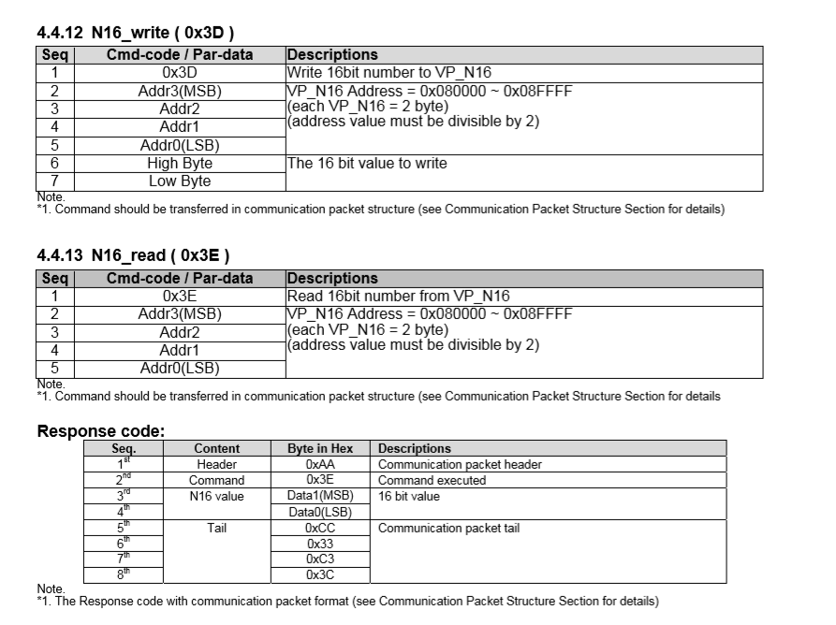
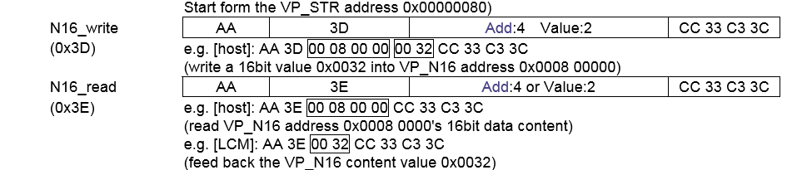
SMART TOUCH LCD

Slide 51
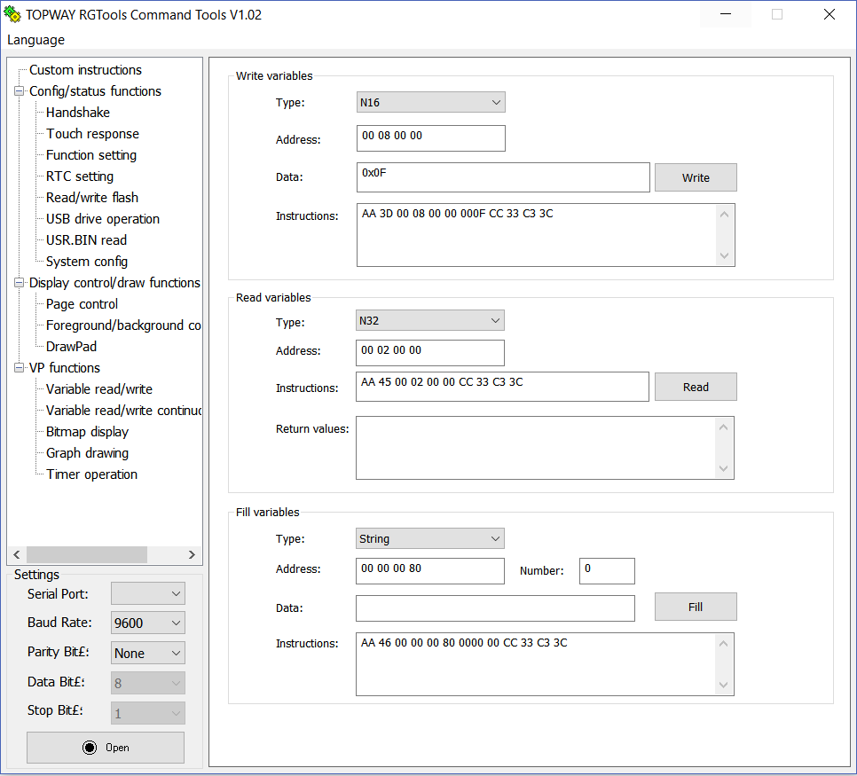
SMART TOUCH LCD

Slide 52
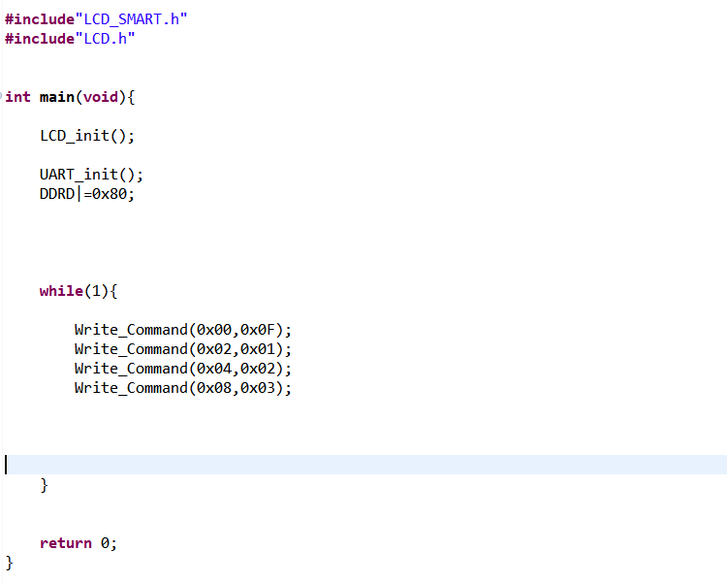
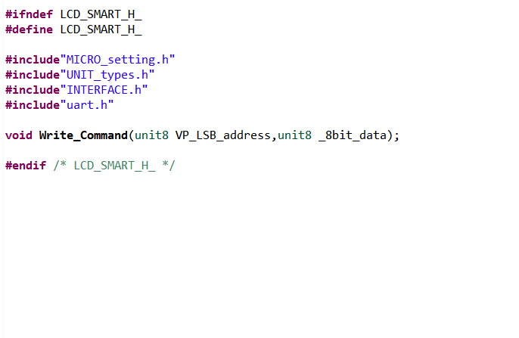
Embedded C programing code

Slide 53
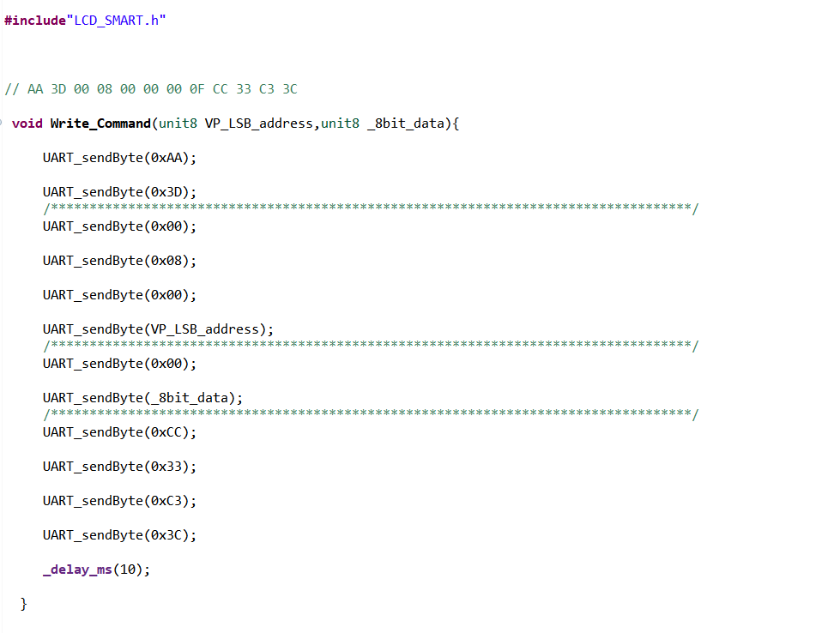
Embedded C programing code

Slide 54
The End.

